Slide 1
Major Elements of the New Electronic Assessment System (EAS)
Presentation at 2014 Assessment Liaison Retreat
May 9, 2014

Slide 2
EAS’s Twofold Purpose
Students upload signature assignments prepared in
Gateway classes in the major
Capstone classes in the major
Faculty able to use stored assignments for assessment exercises
Able to draw random samples
Assessment based on specially created rubrics

Slide 3
EAS’s Major Elements
Assigning Roles
Creating Assignments for Specific Sections
Uploading Assignments
Viewing Uploaded Assignments
Creating Rubrics
Creating an Assessment Study
Carrying Out the Study
Dealing with Outliers
Extracting Summary Information

Slide 4
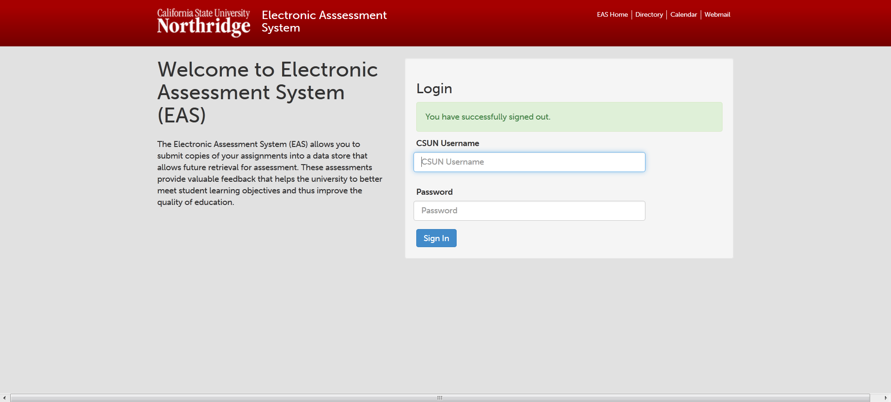

Slide 7
EAS’s Major Elements
Assigning Roles
Creating Assignments for Specific Sections
Uploading Assignments
Viewing Uploaded Assignments
Creating Rubrics
Creating an Assessment Study
Carrying Out the Study
Dealing with Outliers
Extracting Summary Information

Slide 8
EAS Roles:

Slide 9
EAS’s Major Elements
Assigning Roles
Creating Assignments for Specific Sections
Uploading Assignments
Viewing Uploaded Assignments
Creating Rubrics
Creating an Assessment Study
Carrying Out the Study
Dealing with Outliers
Extracting Summary Information

Slide 10
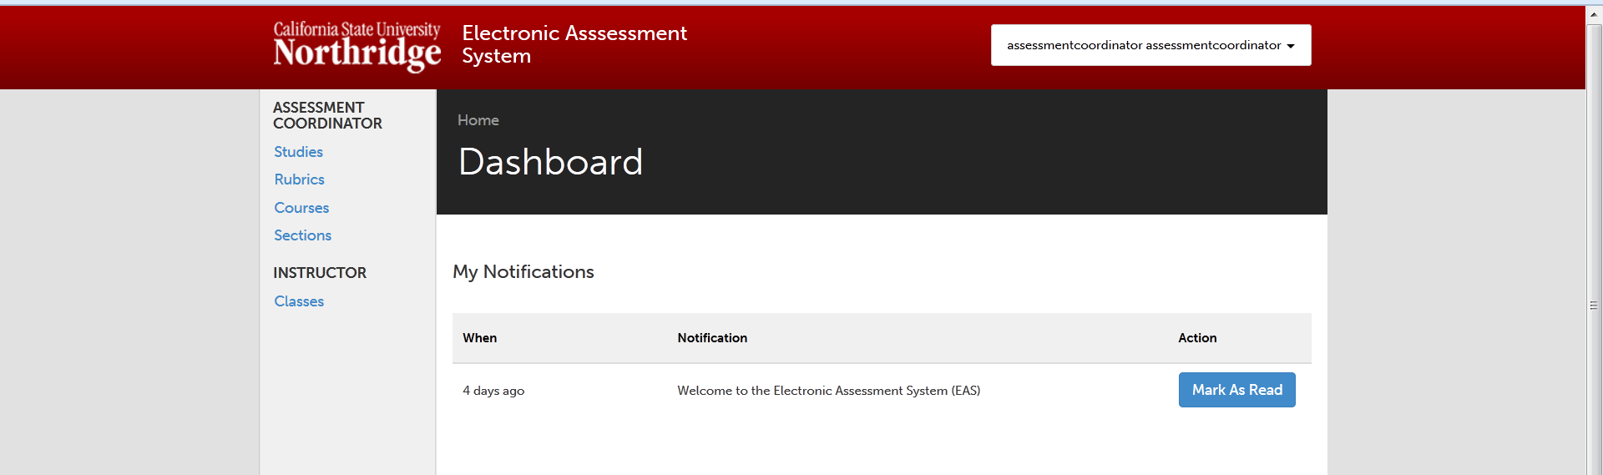

Slide 12
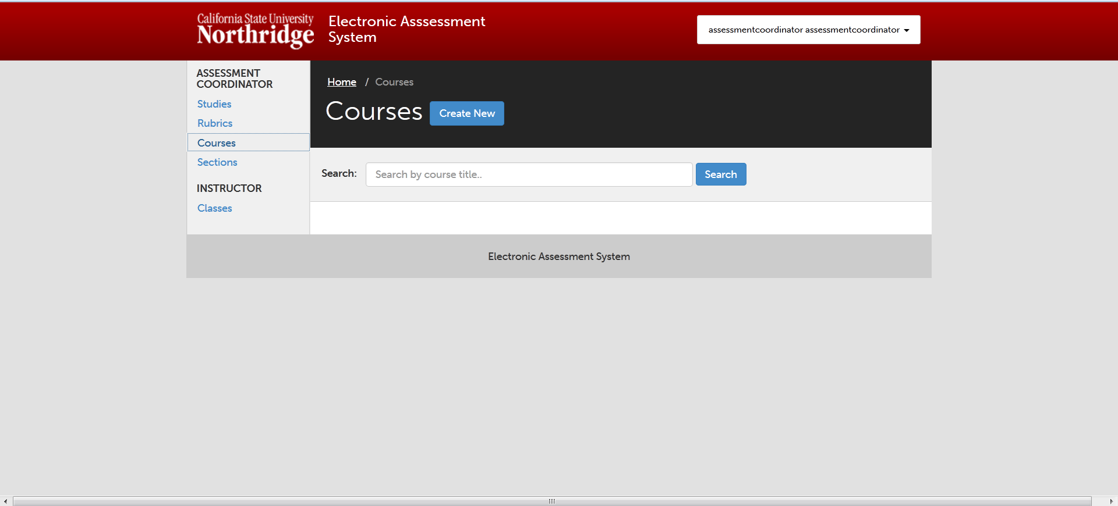

Slide 14
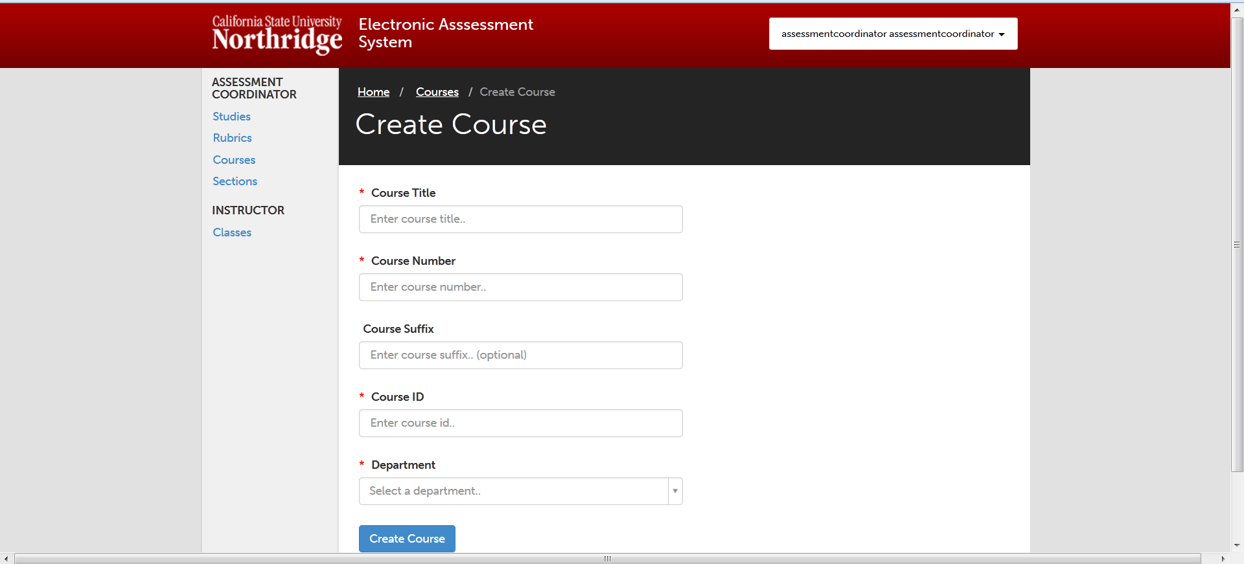

Slide 15


Slide 19
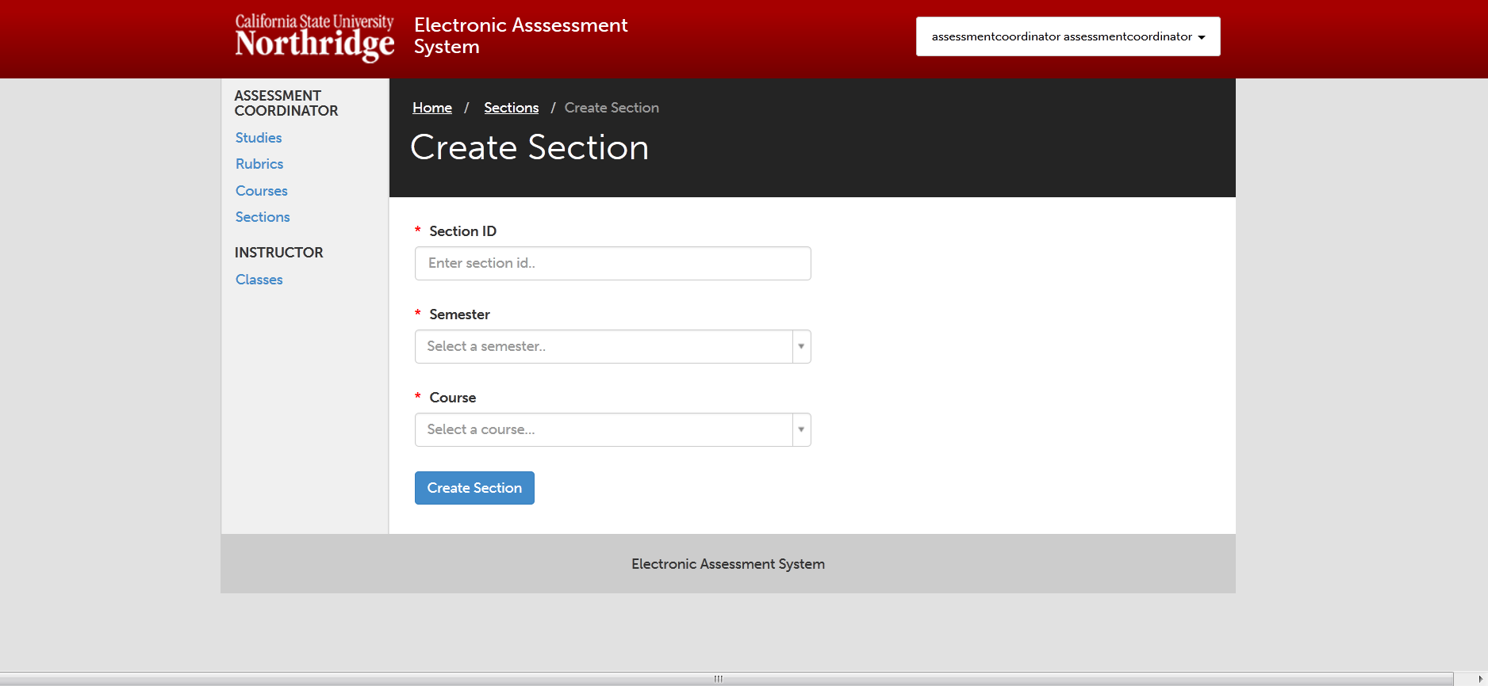

Slide 20
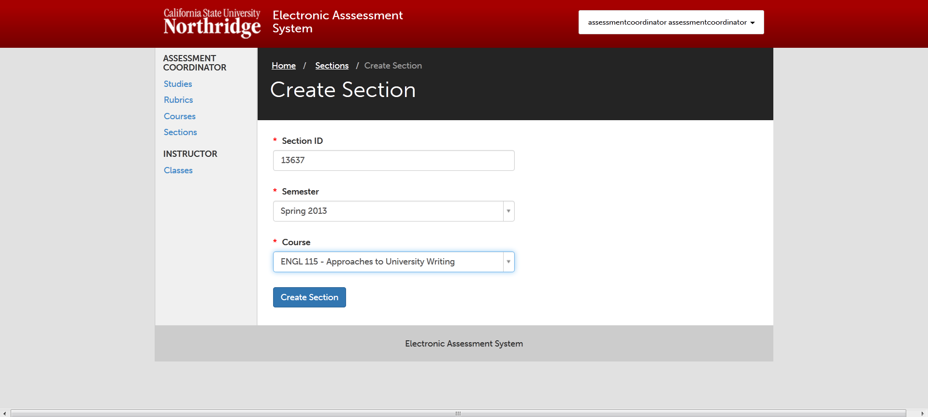

Slide 22
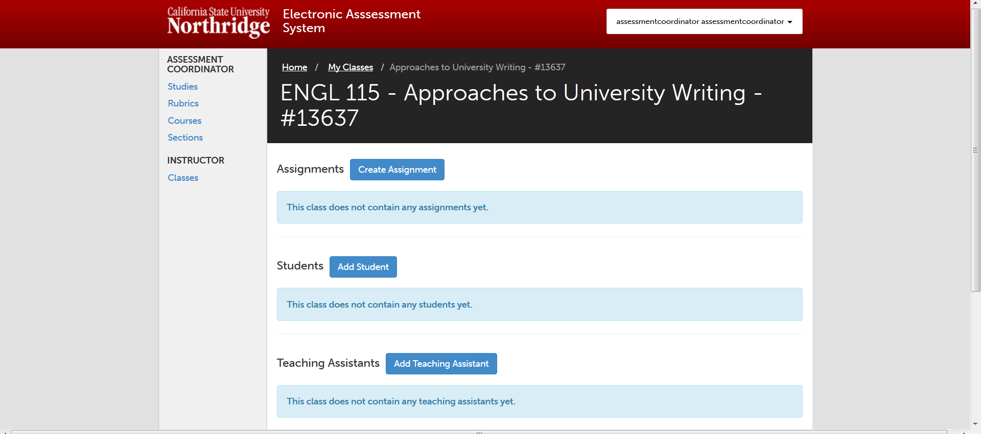

Slide 24
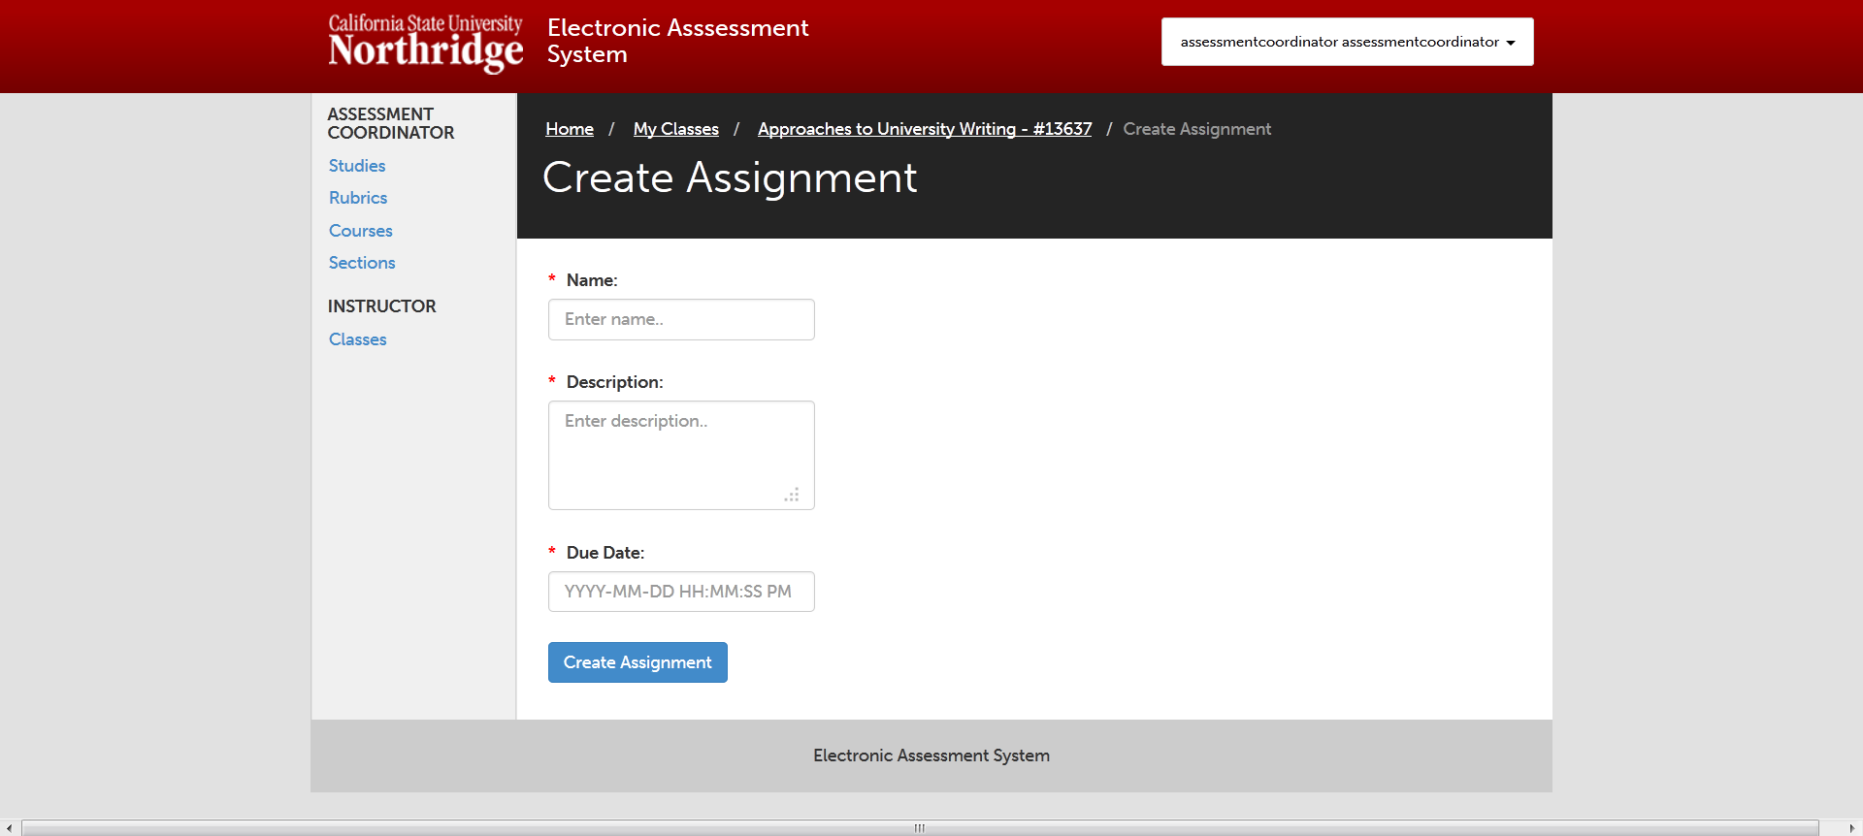

Slide 25
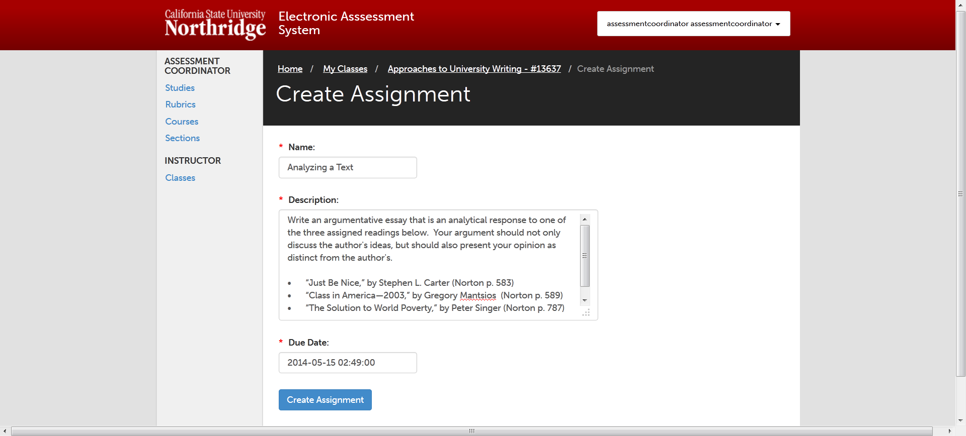

Slide 27
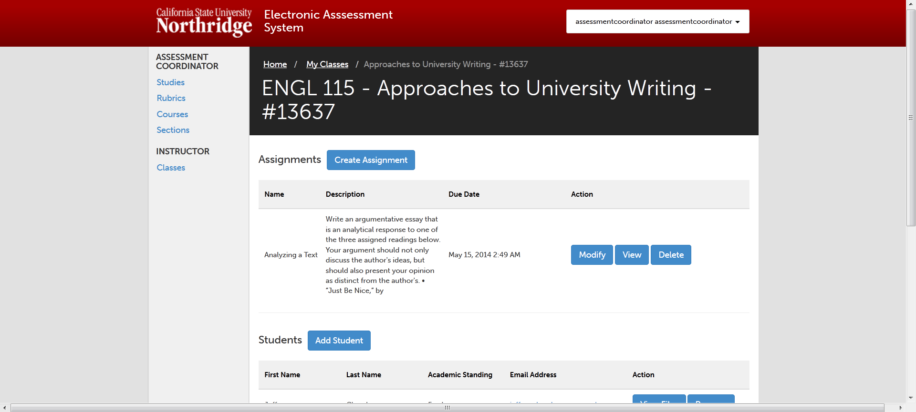

Slide 28
EAS’s Major Elements
Assigning Roles
Creating Assignments for Specific Sections
Uploading Assignments
Viewing Uploaded Assignments
Creating Rubrics
Creating an Assessment Study
Carrying Out the Study
Dealing with Outliers
Extracting Summary Information

Slide 29
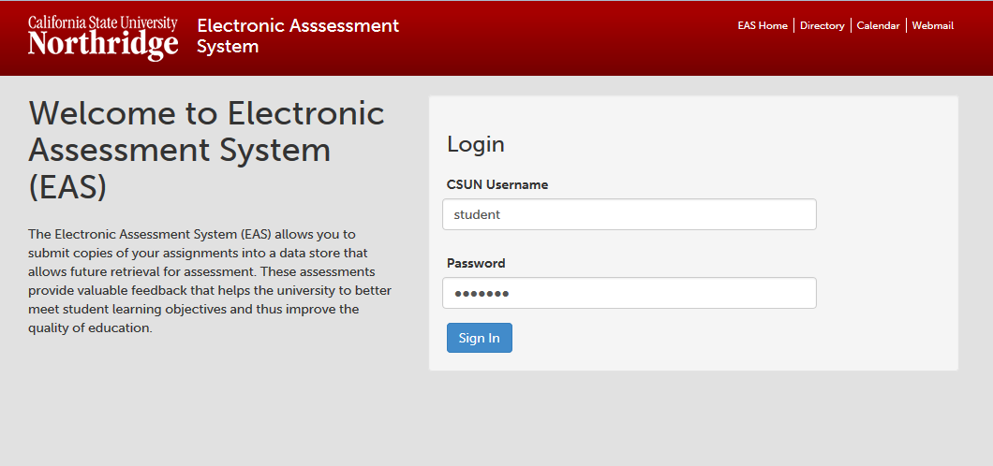
Entry – enter CSUN Username and Password

Slide 30
Entry – enter CSUN Username and Password

Slide 31
Student Dashboard
After students log in, their Student Dashboard appears.
The dashboard lists all of the classes for which a student has been asked to upload documents.

Slide 32
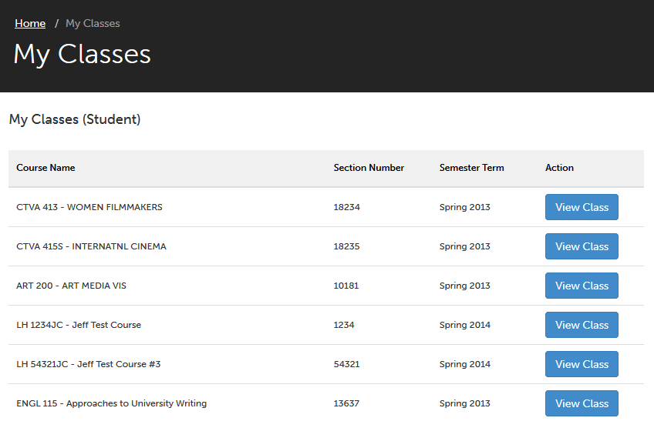
Student Dashboard – Click View Class button to view assignments for that class

Slide 33
Student Dashboard – Click View Class button to view assignments for that class

Slide 34
Student Dashboard – Click View Class button to view assignments for that class

Slide 35
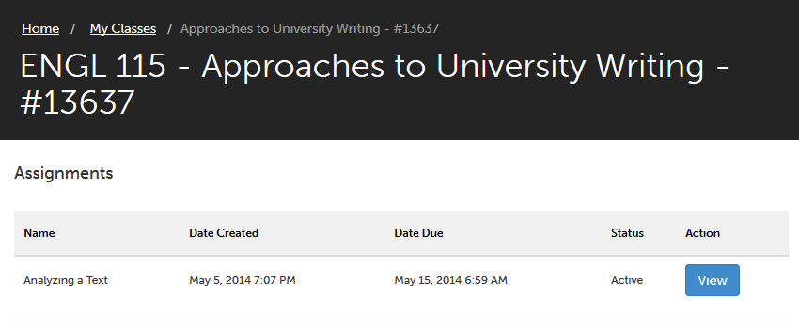
Class Assignment – click View button to see assignment information and to begin uploading documents.

Slide 36
Class Assignment – click View button to see assignment information and to begin uploading documents.

Slide 37
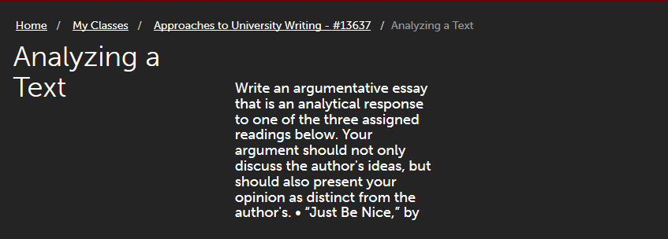
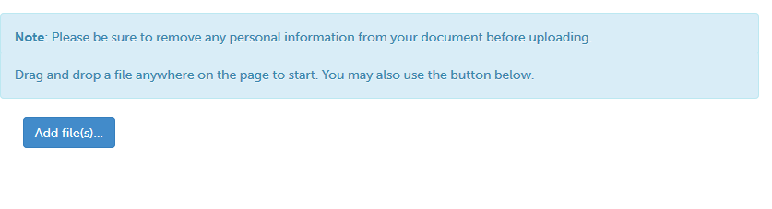
Uploading Documents – click Add File(s) button to upload documents

Slide 38
Uploading Documents – click Add File(s) button to upload documents

Slide 39
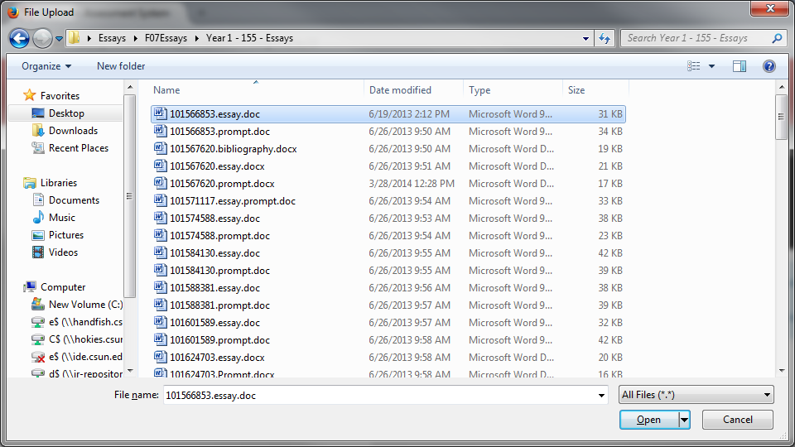
Uploading Documents – select document(s) to upload

Slide 40
Uploading Documents – select document(s) to upload

Slide 41
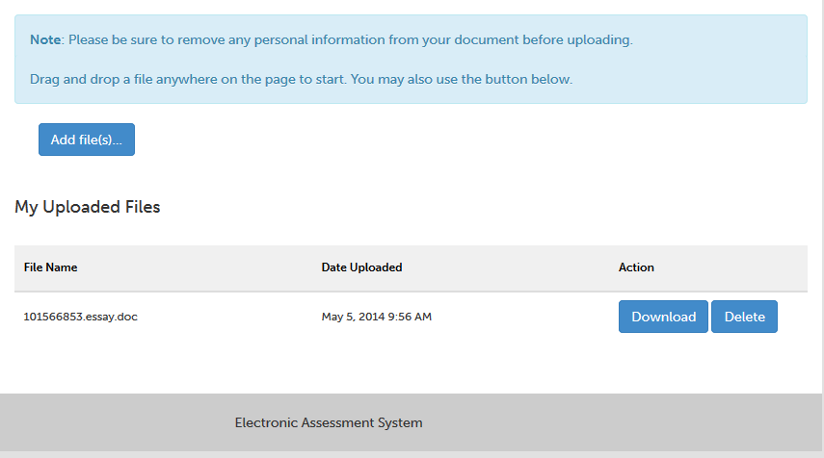
Uploading Documents - the document(s) that were uploaded are shown.

Slide 42
Uploading Documents - the document(s) that were uploaded are shown.

Slide 43
Uploading Documents - the document(s) that were uploaded are shown.

Slide 44
Uploading Documents - the document(s) that were uploaded are shown.

Slide 45

Uploaded Document

Slide 46
EAS’s Major Elements
Assigning Roles
Creating Assignments for Specific Sections
Uploading Assignments
Viewing Uploaded Assignments
Creating Rubrics
Creating an Assessment Study
Carrying Out the Study
Dealing with Outliers
Extracting Summary Information

Slide 47
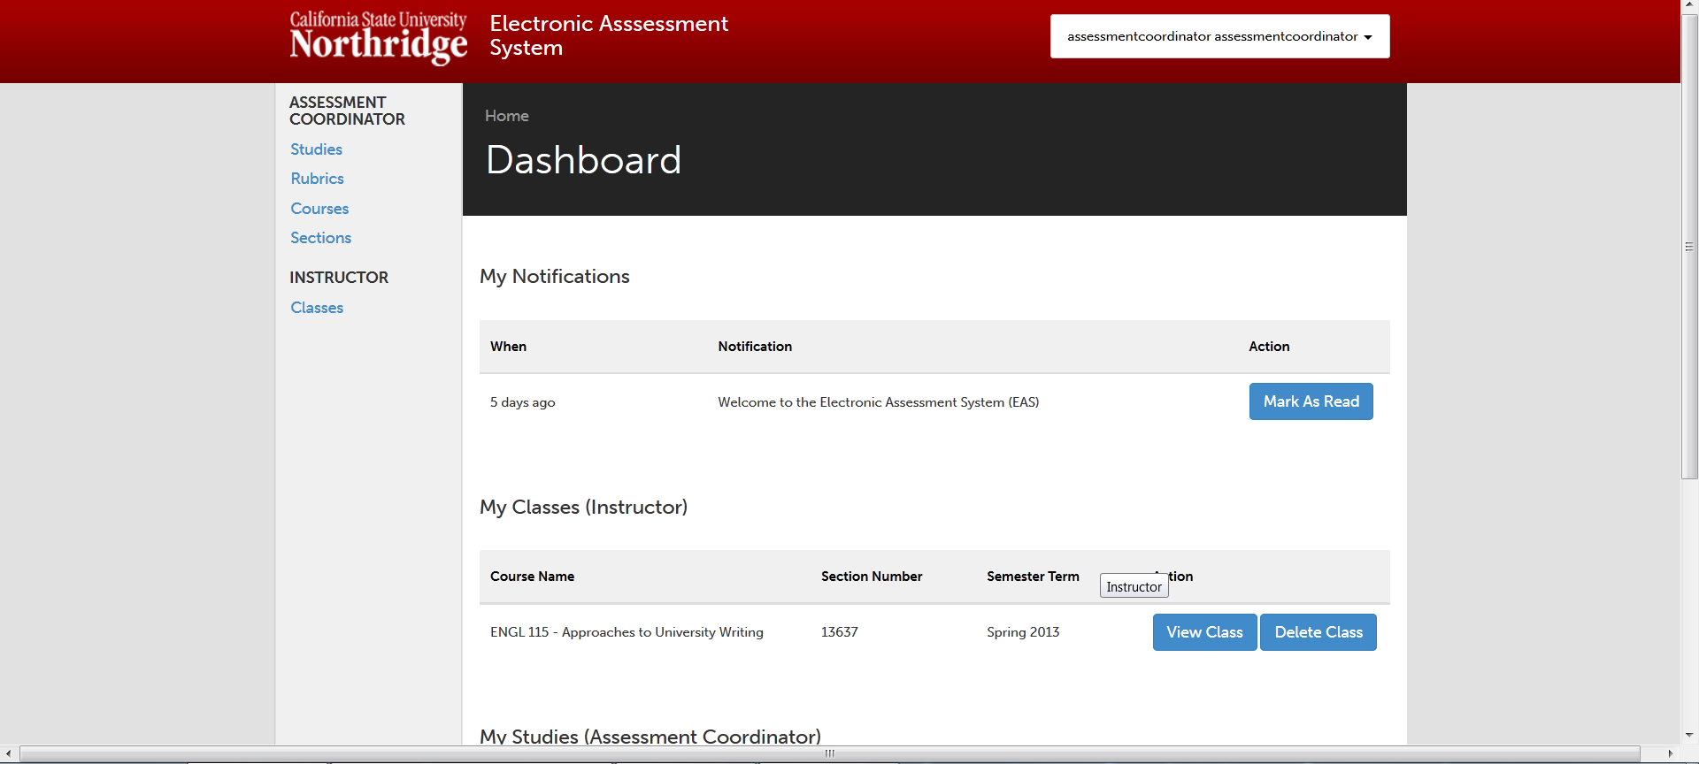

Slide 49
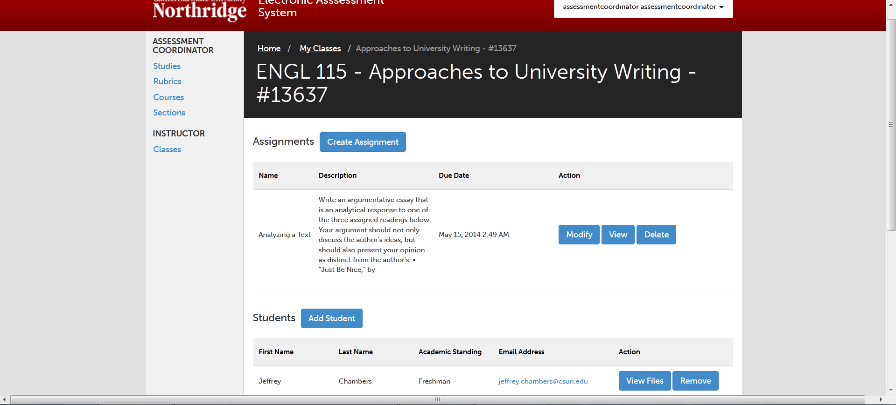

Slide 51
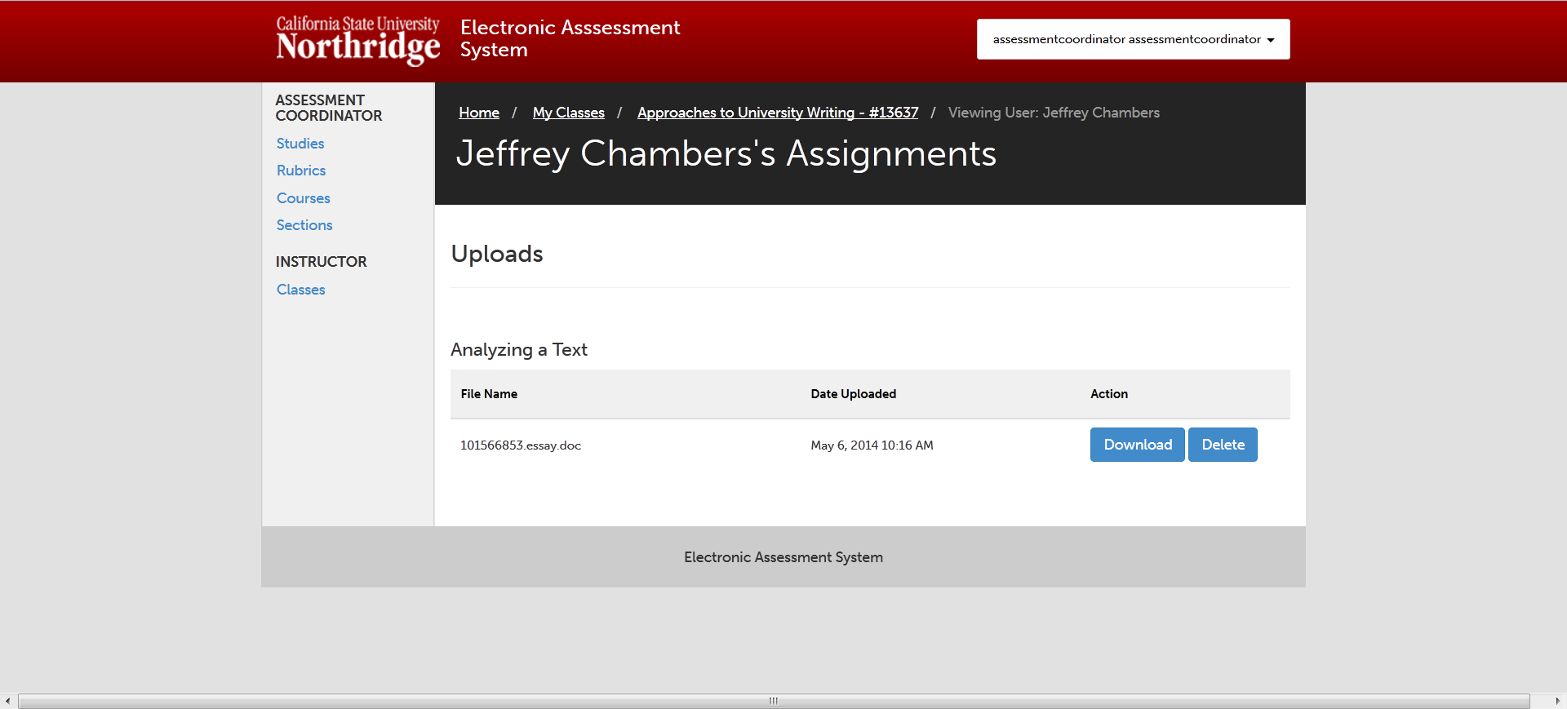

Slide 54
EAS’s Major Elements
Assigning Roles
Creating Assignments for Specific Sections
Uploading Assignments
Viewing Uploaded Assignments
Creating Rubrics
Creating an Assessment Study
Carrying Out the Study
Dealing with Outliers
Extracting Summary Information

Slide 56
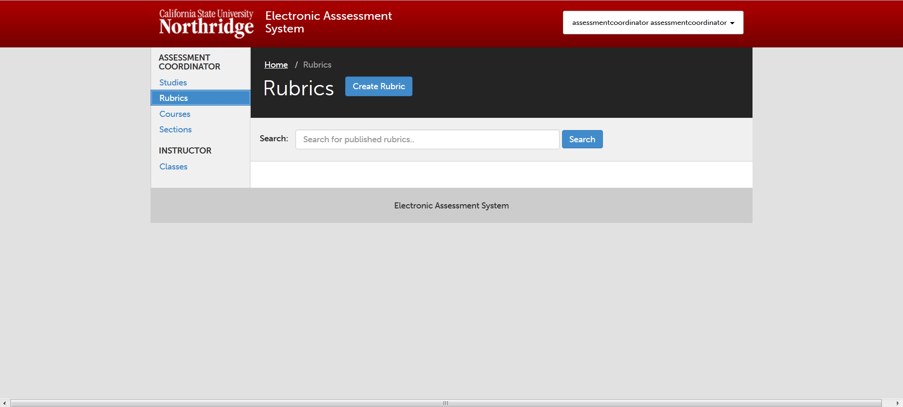

Slide 59
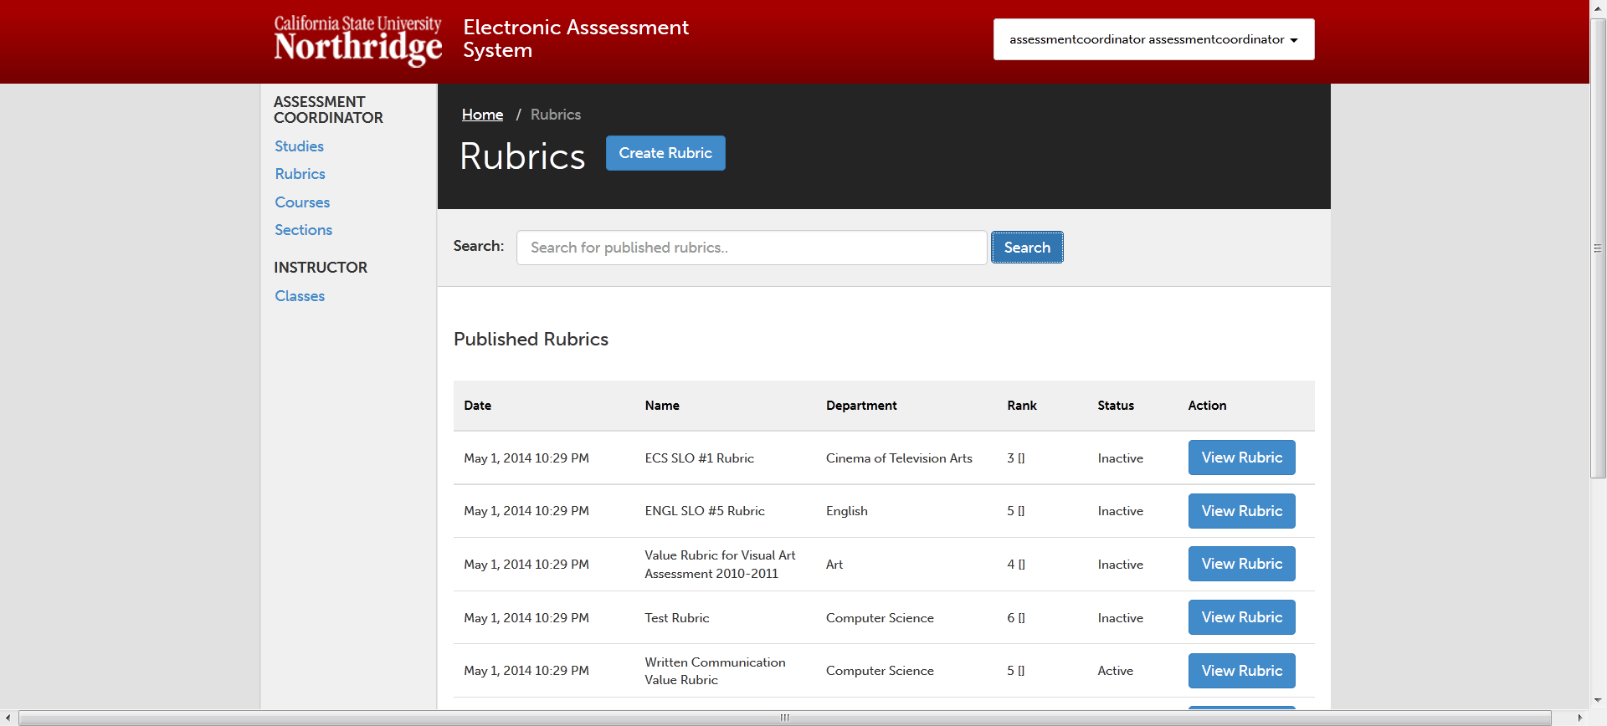

Slide 61
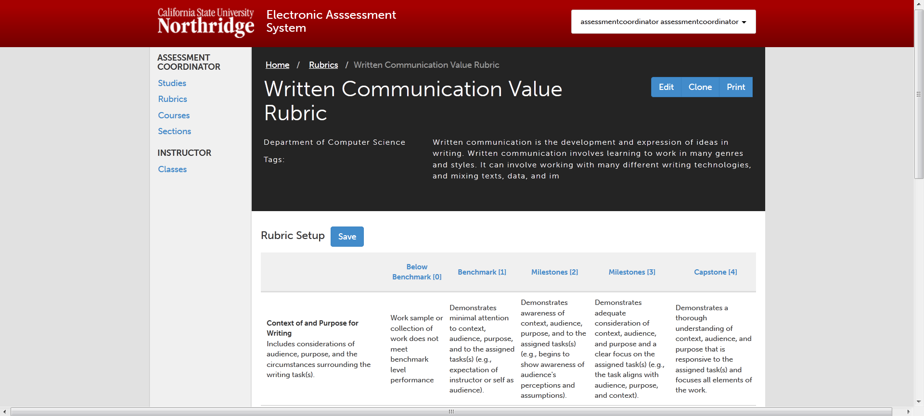

Slide 63
EAS’s Major Elements
Assigning Roles
Creating Assignments for Specific Sections
Uploading Assignments
Viewing Uploaded Assignments
Creating Rubrics
Creating an Assessment Study
Carrying Out the Study
Dealing with Outliers
Extracting Summary Information

Slide 66
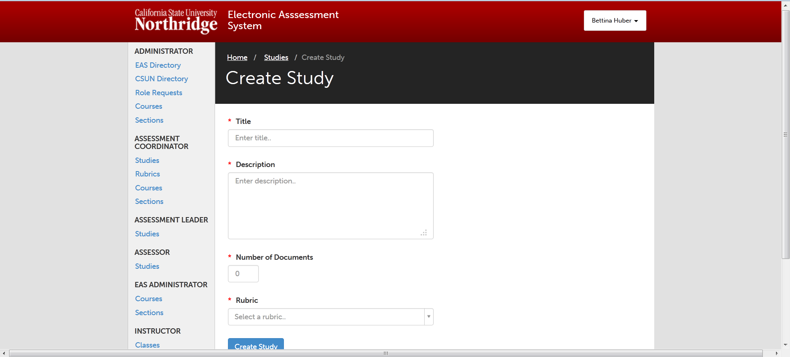

Slide 67
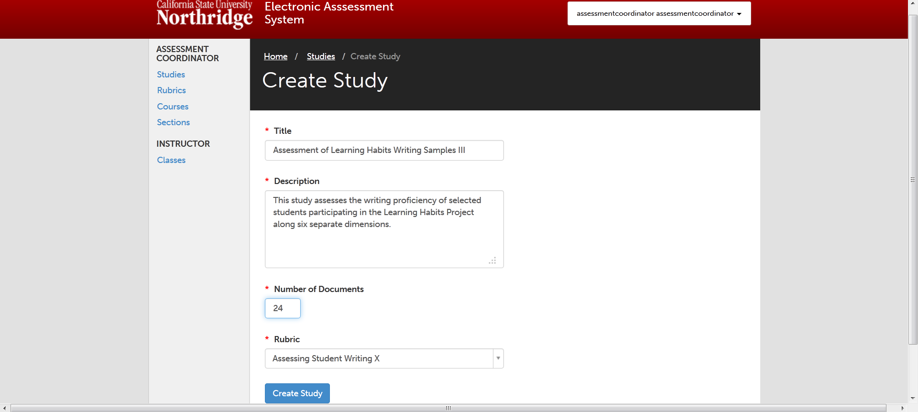

Slide 71
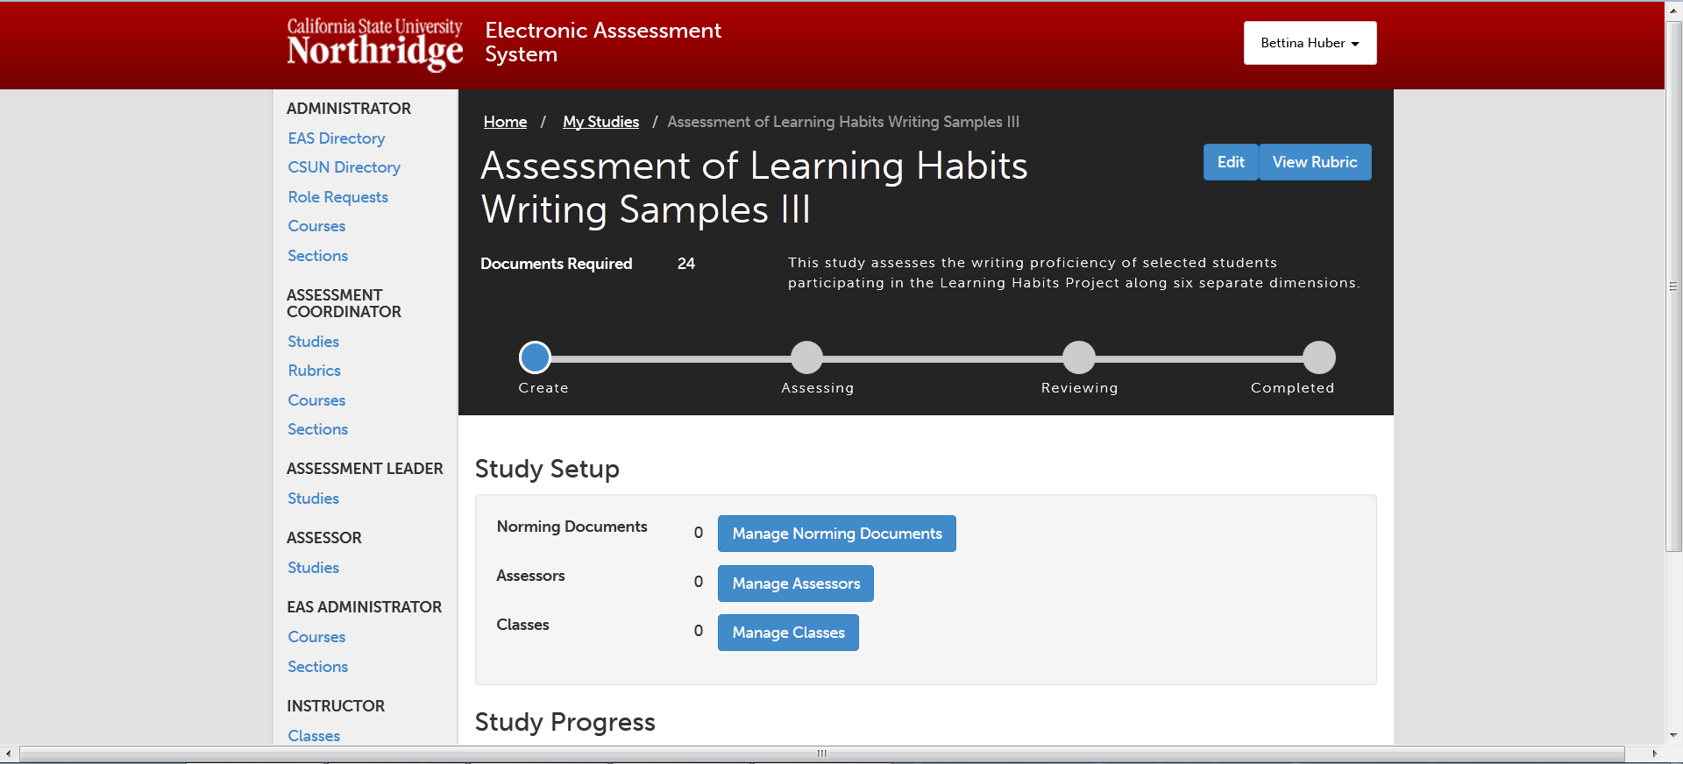

Slide 74
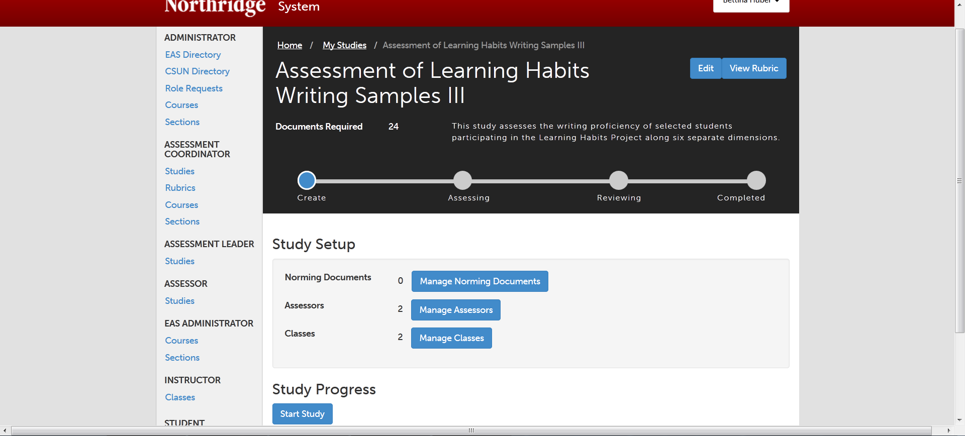

Slide 75
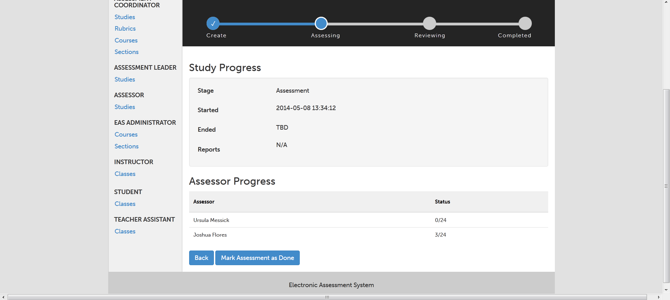

Slide 77
EAS’s Major Elements
Assigning Roles
Creating Assignments for Specific Sections
Uploading Assignments
Viewing Uploaded Assignments
Creating Rubrics
Creating an Assessment Study
Carrying Out the Study
Dealing with Outliers
Extracting Summary Information

Slide 78
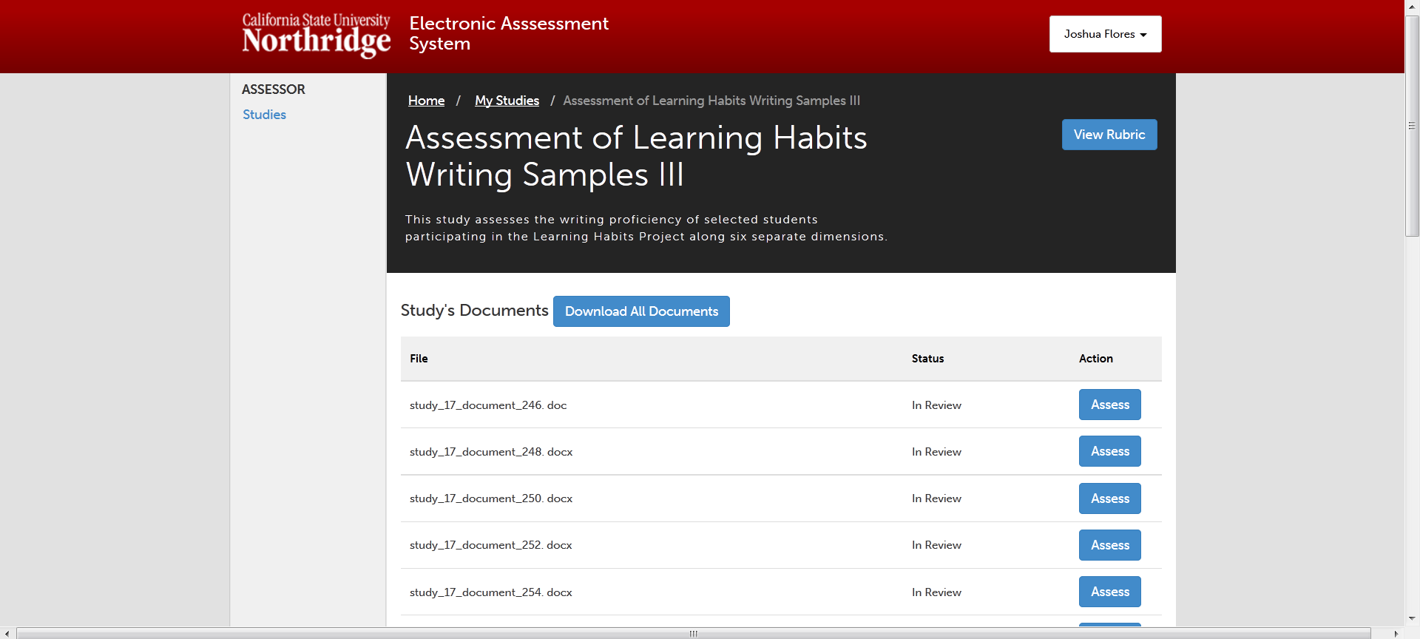

Slide 80
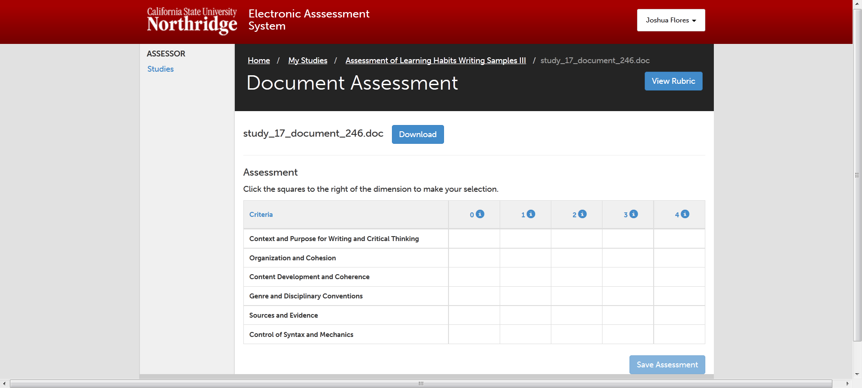

Slide 81
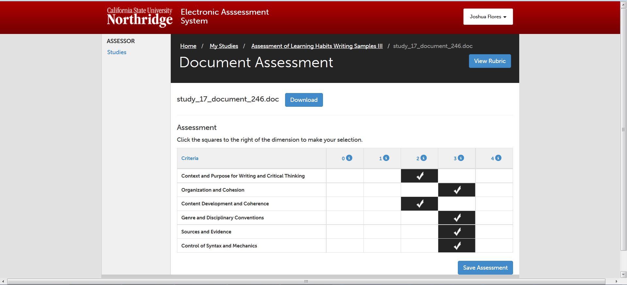

Slide 82
EAS’s Major Elements
Assigning Roles
Creating Assignments for Specific Sections
Uploading Assignments
Viewing Uploaded Assignments
Creating Rubrics
Creating an Assessment Study
Carrying Out the Study
Dealing with Outliers
Extracting Summary Information

Slide 83
EAS’s Major Elements
Assigning Roles
Creating Assignments for Specific Sections
Uploading Assignments
Viewing Uploaded Assignments
Creating Rubrics
Creating an Assessment Study
Carrying Out the Study
Dealing with Outliers
Extracting Summary Information

Slide 84
System Refinements During Summer 2014
Upload Essays in Selected Courses
Participate in Abbreviated Assessment Exercises

Slide 85
Use of New Electronic System to Inform Interim WASC Report
Fall 2014 and Spring 2015: upload Gateway and Capstone writing samples into new electronic system
Spring 2015: begin to undertake cross-sectional assessment exercises, after training in rubric creation, norming, and use of electronic system
Fall 2015 and Spring 2016: continue assessment exercises and routinize essay uploading
Spring 2016 and Summer 2016: preparation of WASC Interim Report
Fall 2016: WASC Interim Report due

Slide 86
Questions and Comments

